Slide 1
Introduction to Data Science & Artificial Intelligence
By,
Shweta Pramod Sutar

Slide 2
Outline
Data, Big Data, and Challenges
Data Science
Introduction
Why Data Science
Data Scientists
What do they do?
Major/Concentration in Data Science
What courses to take.

Slide 3




Data All Around
Lots of data is being collected and warehoused
Web data, e-commerce
Financial transactions, bank/credit transactions
Online trading and purchasing
Social Network

Slide 4
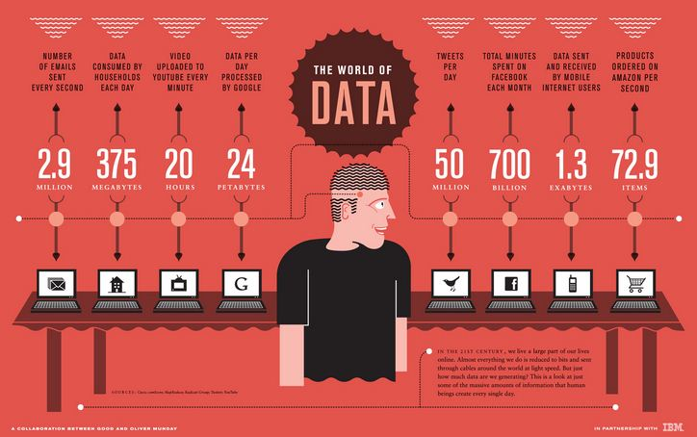
How Much Data Do We have?
Google processes 20 PB a day (2008)
Facebook has 60 TB of daily logs
eBay has 6.5 PB of user data + 50 TB/day (5/2009)
1000 genomes project: 200 TB
Cost of 1 TB of disk: $35
Time to read 1 TB disk: 3 hrs
(100 MB/s)

Slide 5
Big Data
Big Data is any data that is expensive to manage and hard to extract value from
Volume
The size of the data
Velocity
The latency of data processing relative to the growing demand for interactivity
Variety and Complexity
the diversity of sources, formats, quality, and structures.

Slide 6
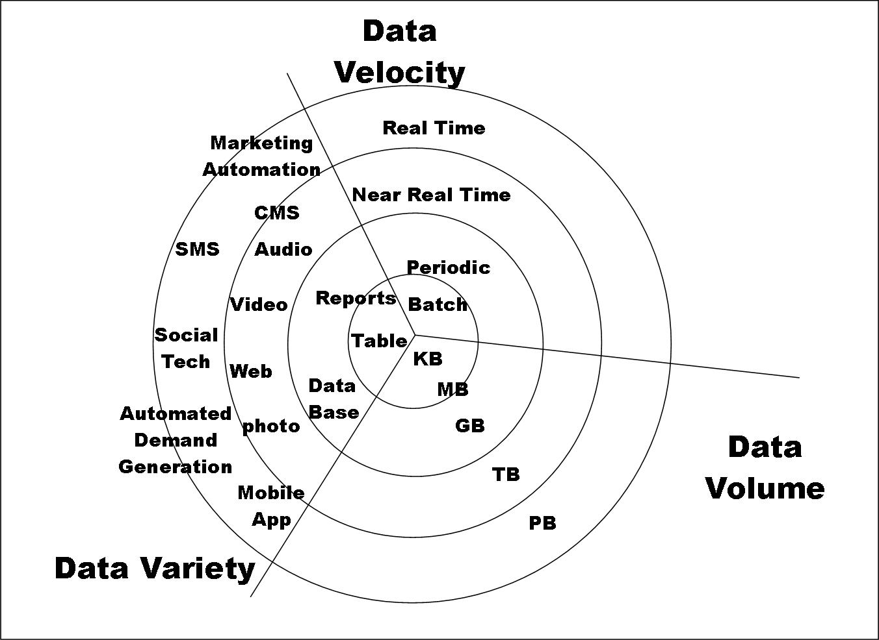
Big Data

Slide 7
Types of Data We Have
Relational Data (Tables/Transaction/Legacy Data)
Text Data (Web)
Semi-structured Data (XML)
Graph Data
Social Network, Semantic Web (RDF), …
Streaming Data

Slide 8
What To Do With These Data?
Aggregation and Statistics
Data warehousing and OLAP
Indexing, Searching, and Querying
Keyword-based search
Pattern matching (XML/RDF)
Knowledge discovery
Data Mining
Statistical Modeling

Slide 9
What is Data Science?
An area that manages, manipulates, extracts, and interprets knowledge from a tremendous amount of data
Data Science (DS) is a multidisciplinary field of study with the goal to address the challenges in big data
Data science principles apply to all data – big and small

Slide 10
What is Data Science?
Theories and techniques from many fields and disciplines are used to investigate and analyze a large amount of data to help decision-makers in many industries such as science, engineering, economics, politics, finance, and education
Computer Science
Pattern recognition, visualization, data warehousing, High-performance computing, Databases, AI
Mathematics
Mathematical Modeling
Statistics
Statistical and Stochastic modeling, Probability.

Slide 11
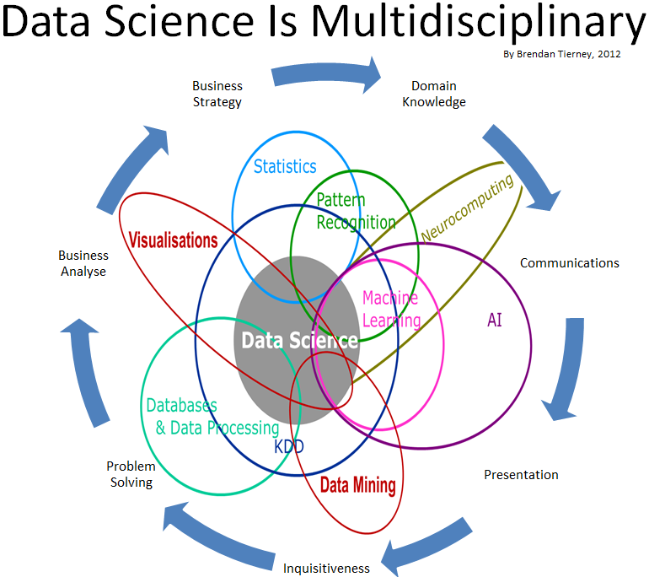

Slide 12

Data Scientists
The Hottest Job of the 21st Century.
They find stories and extract knowledge. They are not reporters
Data scientists are the key to realizing the opportunities presented by big data.
They bring structure to it, find compelling patterns in it, and advise executives on the implications for products, processes, and decisions

Slide 13
What do Data Scientists do?
National Security
Cyber Security
Business Analytics
Engineering
Healthcare
And more ….

Slide 14
Concentration in Data Science
Mathematics and Applied Mathematics
Applied Statistics/Data Analysis
Solid Programming Skills (R, Python, Julia, SQL)
Data Mining
Data Base Storage and Management
Machine Learning and discovery

Slide 15
Artificial Intelligence
1. Sophia, the social humanoid robot created by Dr. David Hanson (Hanson Robotics) was granted citizenship in October 2016.
2.AI Virtual Assistants ->Siri, Google Assistant, Microsoft’s Cortana, Amazon Echo
3. Intelligent Car->Tesla Autopilot, Google Waymo, Ford’s Argo
4.AI Gaming->Google DeepMind’s AlphaGo, AI in Chess
The technology enabling this revolution is artificial intelligence. It is the capability of a machine to imitate human behavior.

